Slide 1
PhD Works
Enes Ayaz

Slide 2
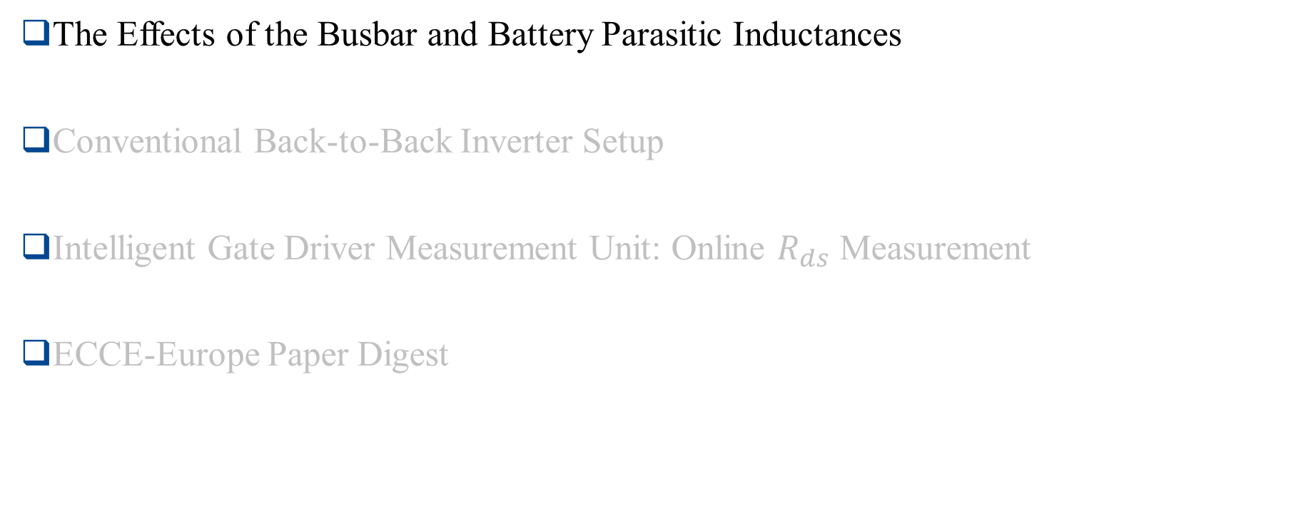
Outline
The Effects of the Busbar and Battery Parasitic Inductances
Conventional Back-to-Back Inverter Setup
Intelligent Gate Driver Measurement Unit: Online $R_{ds}$ Measurement
ECCE-Europe Paper Digest

Slide 3
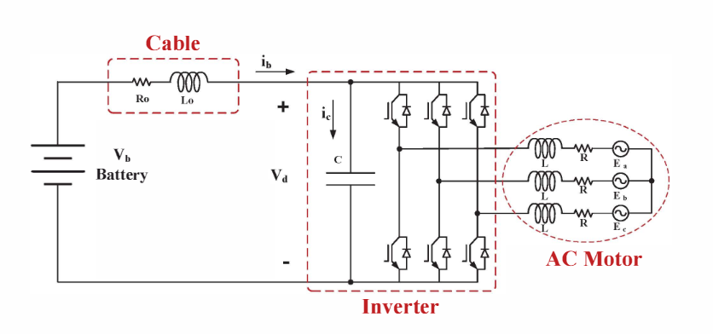
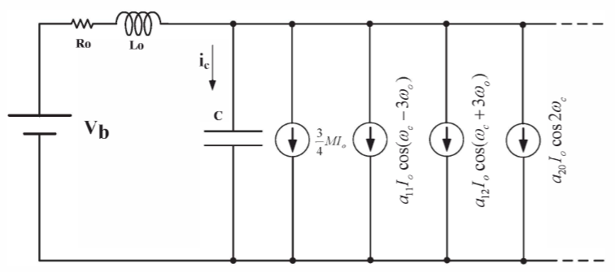
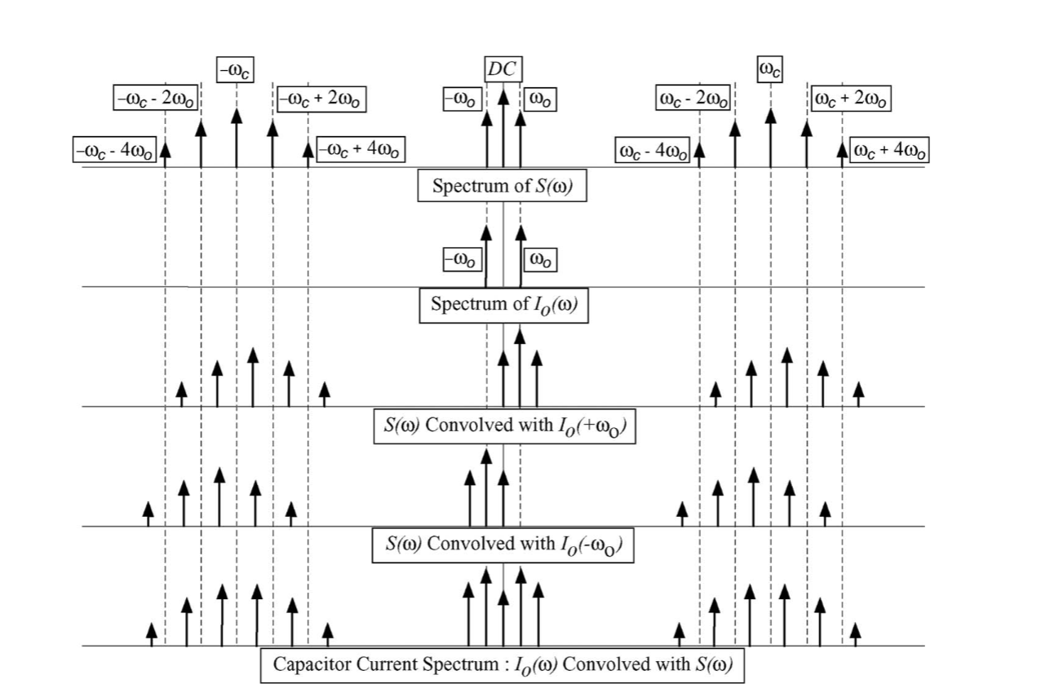
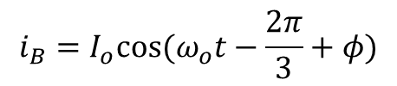



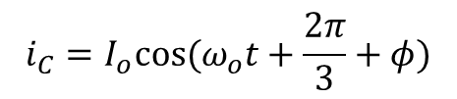
Simplified Inverter Model
We do not consider output harmonics for the phase currents
$$i_{A}=I_{o}cos⁡(ω_{o}t+φ)$$
$$i_{B}=I_{o}cos⁡(ω_{o}t−\frac{2π}{3}+φ)$$
$$i_{inv}=S_{A}i_{A}+S_{B}i_{B}+S_{C}i_{c}$$
$$i_{C}=I_{o}cos⁡(ω_{o}t+\frac{2π}{3}+φ)$$
Combined Inverter and battery model
Leg current in the frequency domain is the convolution of the phase current and switching function.
$S_{A}(t)i_{A}(t)$➔$S_{A}(ω){∗ I}_{A}(ω)$
The inverter can be modeled as current sources of harmonic components.

Slide 4
The Aim of Using Impedance Model
High impedance points
A simplified model does not provide the effective capacitance values for each phase.
Additionally, a resonant structure is created because of the capacitors and stray inductances, which create high impedance for some frequencies.

Slide 5

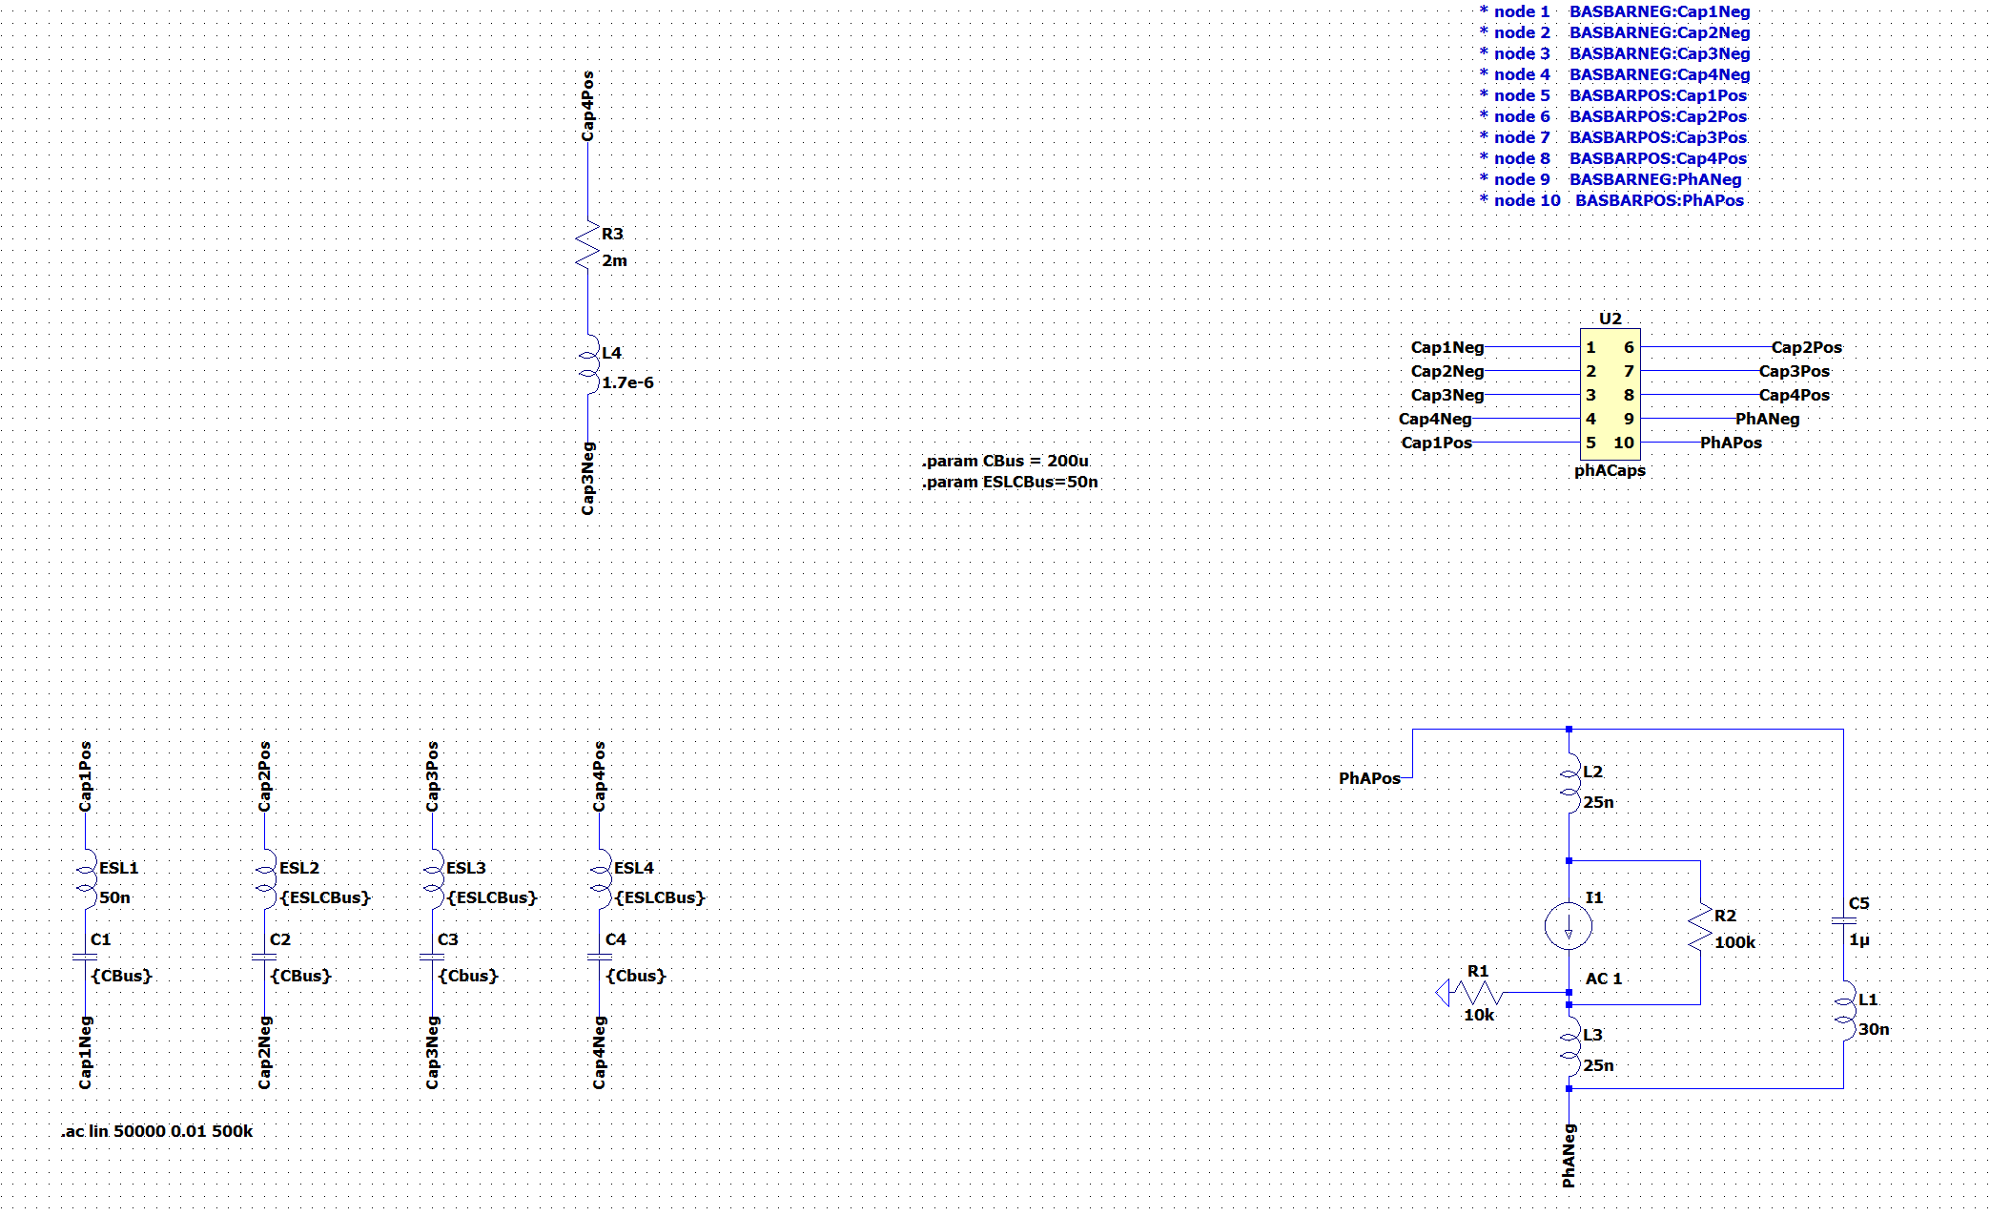
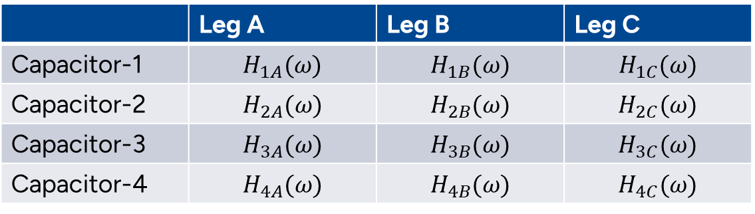
Busbar Geometry 62mm Power Module
Step response of capacitors to each leg
 | Leg A | Leg B | Leg C
Capacitor-1 | $$H_{1A}(ω)$$ | $$H_{1B}(ω)$$ | $$H_{1C}(ω)$$
Capacitor-2 | $$H_{2A}(ω)$$ | $$H_{2B}(ω)$$ | $$H_{2C}(ω)$$
Capacitor-3 | $$H_{3A}(ω)$$ | $$H_{3B}(ω)$$ | $$H_{3C}(ω)$$
Capacitor-4 | $$H_{4A}(ω)$$ | $$H_{4B}(ω)$$ | $$H_{4C}(ω)$$
C3
C4
C2
C1
The response of capacitor A for each leg should be calculated as:
$I_{capA}= {(S_{A}∗I_{A} )H}_{1A}\left(ω\right)+{(S_{B}∗I_{B} )H}_{1B}\left(ω\right)$+${(S_{C}∗I_{C} )H}_{1C}\left(ω\right)$
Capacitor
Power Modules
DC- Nodes
DC+ Nodes

Slide 6
DC Link Current (Positive/Negative/Zero Sequences)
6th 12th

Slide 7
Without Battery Model
Capacitor Responses to Phase-A
Capacitor-1 Response to All-phases

Slide 8
The Effect of the Battery Connection
Capacitor-1 Response to All-phases
Capacitor Responses to Phase-A
High frequency
resonance
High frequency
resonance
Low frequency resonance
Low frequency resonance

Slide 9
High Frequency Resonance
14 kHz Switching
24kHz Switching
Harmonic number
Harmonic number
P.S: The high-frequency resonance might be considerable if we have a dual-3-phase-inverter (6-phase) structure and we desire to interleave them to reduce capacitance requirements. (We should look at phase-response (not magnitude response) at such a scenario)

Slide 10
Low Frequency Resonance
700 Hz Fundamental
200 Hz Fundamental

Slide 11
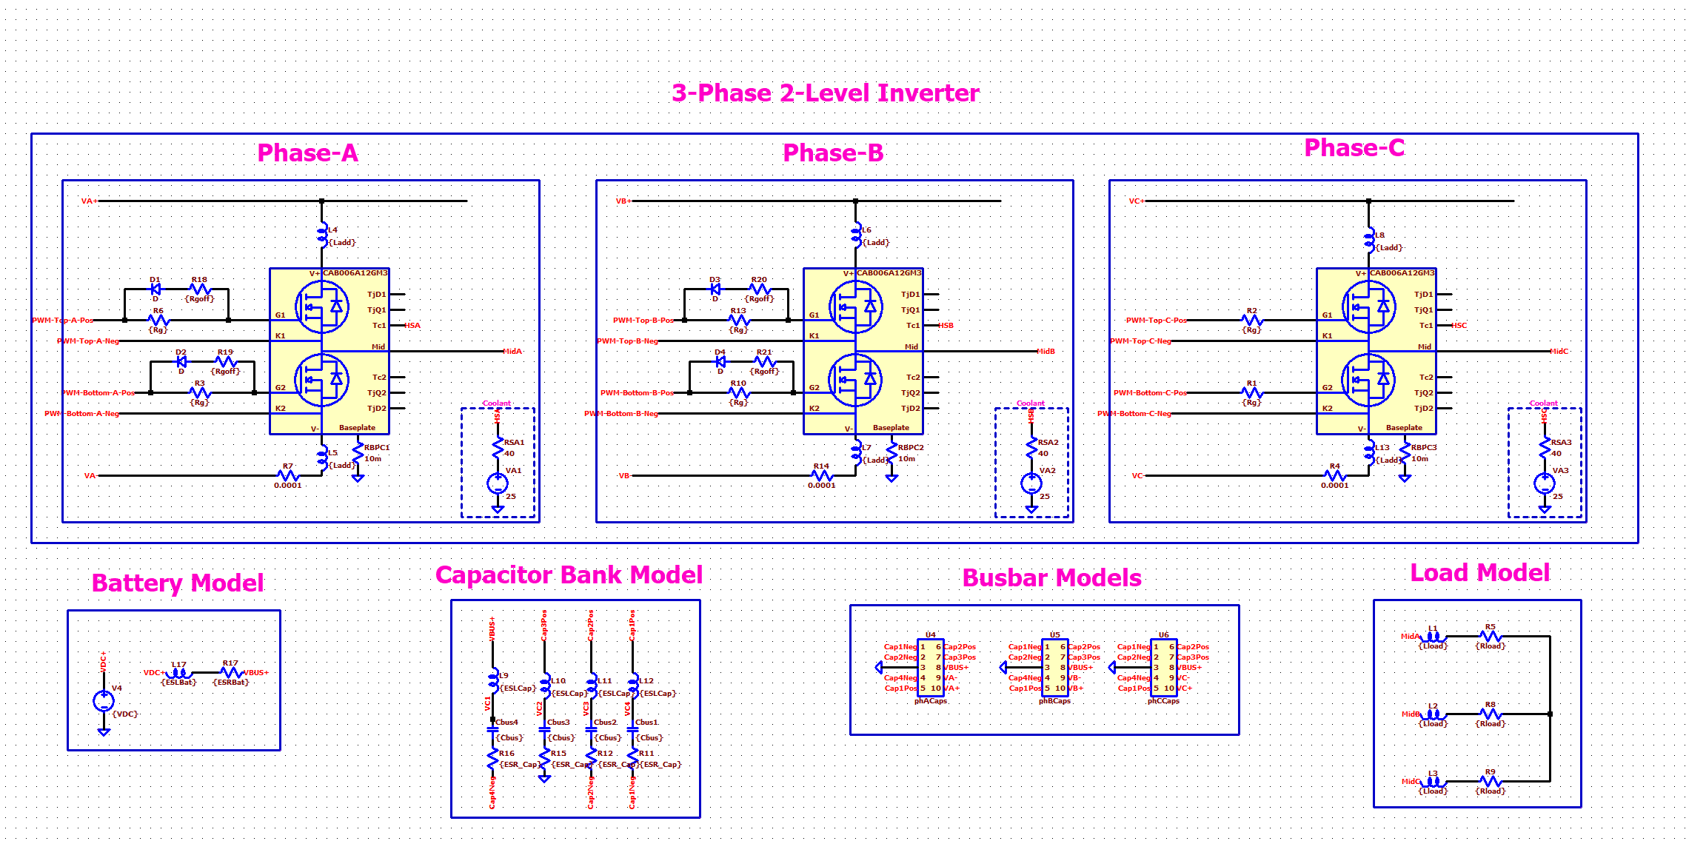
Parasitic Inductances (Switching Speed Limitation)
Parasitic Sources | Inductance
Power module | 50 nH
Capacitor ESL | 50nH
Busbar | Overall <20nH

Slide 12
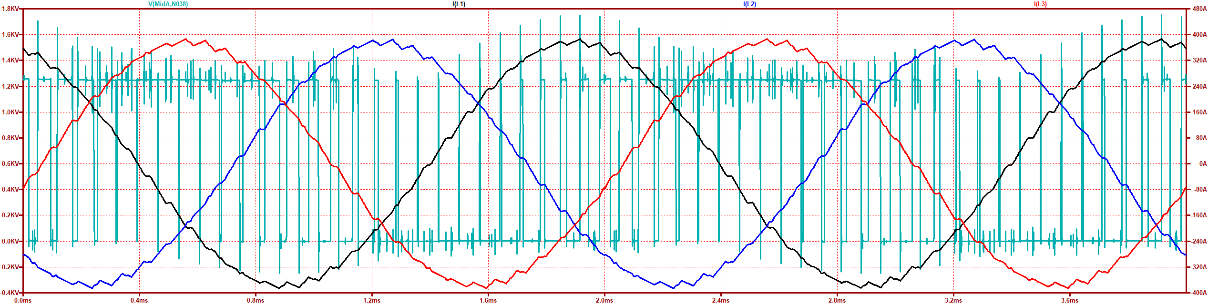
Parasitic Inductances (Switching Speed Limitation)
Maximum Current (MaxA) (inA) | dv/dt (in V/nS) @ MaxA | Overshoot (in %) @ MaxA
380 A | 35 V/ns | 40 %
Phase-A Current
Phase-B Current
Phase-C Current
Drain-source Voltage
Leg-A
Bottom Switch

Slide 13
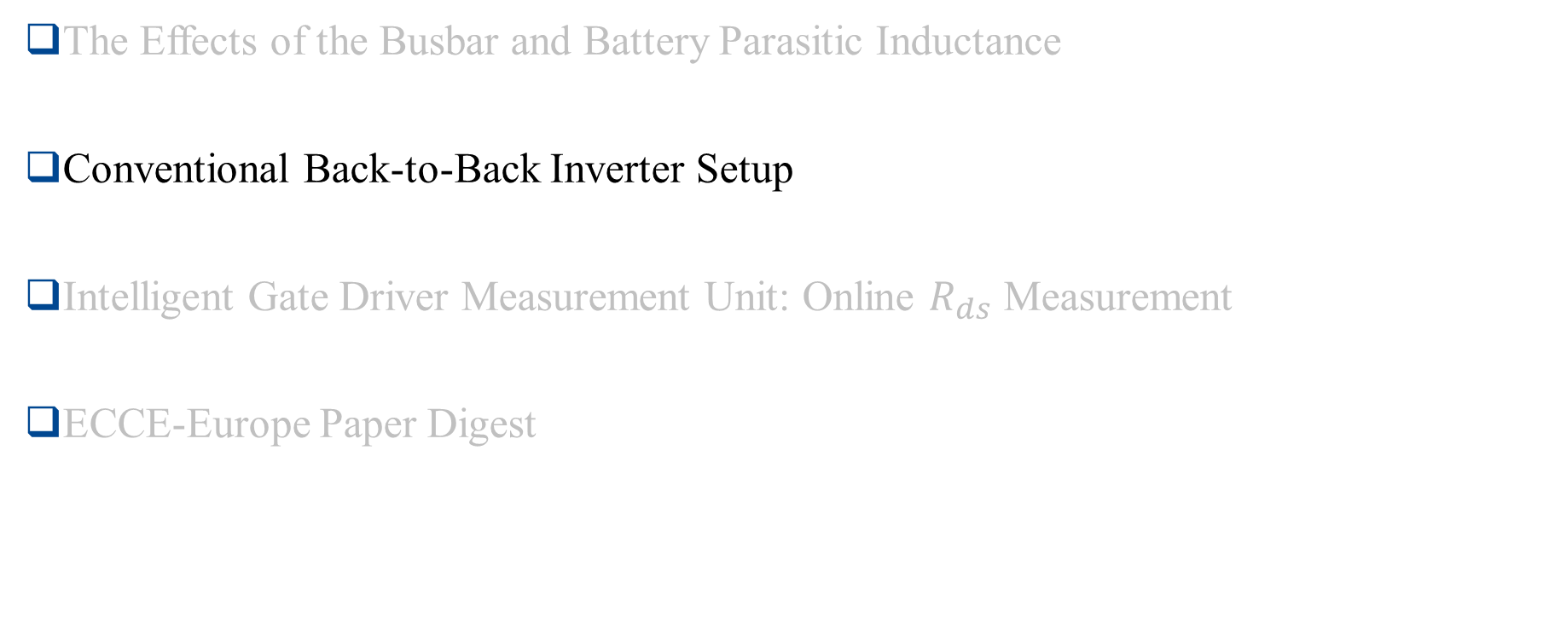
Outline
The Effects of the Busbar and Battery Parasitic Inductance
Conventional Back-to-Back Inverter Setup
Intelligent Gate Driver Measurement Unit: Online $R_{ds}$ Measurement
ECCE-Europe Paper Digest

Slide 14
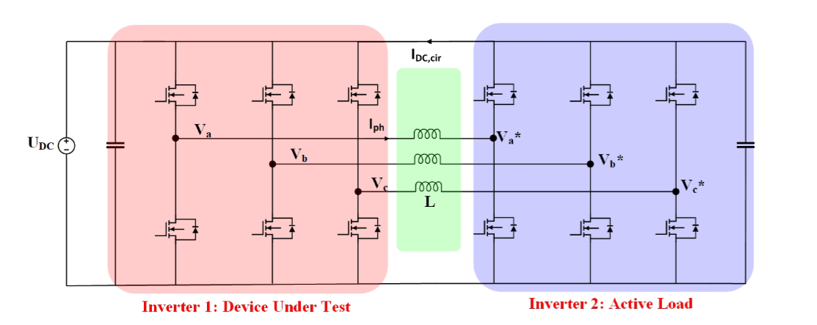
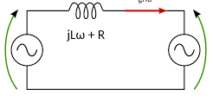
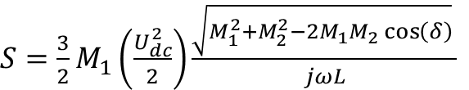



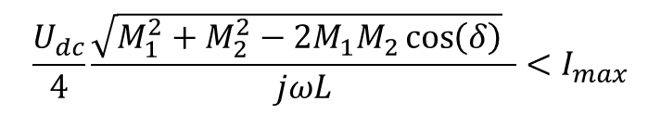

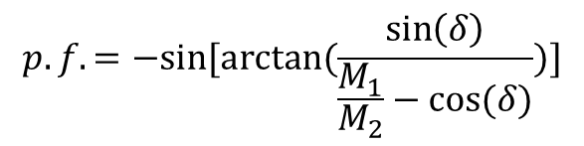
Back-to-Back Inverter
$$P=\frac{V_{ph1}V_{ph2}\sin\left(δ\right)}{jωL}$$
Q$=\frac{V_{ph1}^{2} − V_{ph1}V_{ph2}\cos\left(δ\right)}{jωL}$
$V_{ph1}=\frac{1}{\sqrt{2}}U_{dc}\frac{{ M}_{1}}{2}$
$V_{ph2}=\frac{1}{\sqrt{2}}U_{dc}\frac{{ M}_{2}}{2}$
$S=\frac{3}{2}M_{1}\left(\frac{U_{dc}^{2}}{2}\right)\frac{\sqrt{M_{1}^{2}+M_{2}^{2}−2M_{1}M_{2}\cos\left(δ\right)} }{jωL}$
Iph
$$p.f.=−sin⁡[arctan⁡(\frac{\sin\left(δ\right)}{\frac{M_{1}}{M_{2}}−cos⁡(δ)})]$$
Vph1
Vph2
When two AC voltage sources are connected through an inductance, the power flow between them depends on the phase difference between the voltages of the two sources and the reactance of the connecting inductance.
$$\frac{U_{dc}}{4}\frac{\sqrt{M_{1}^{2}+M_{2}^{2}−2M_{1}M_{2}\cos\left(δ\right)} }{jωL}<I_{max}$$
Y. Luo, "A Variable Power Factor High Power Testbed for Traction Inverter Using Back-to-Back Connection,"

Slide 15
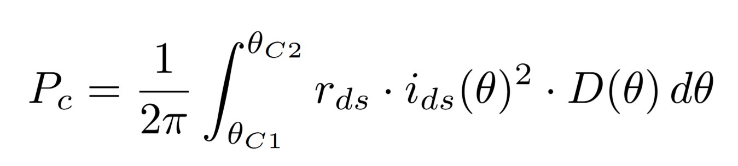
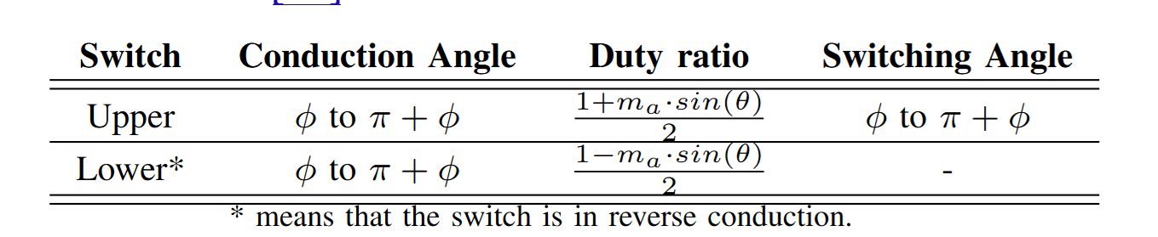
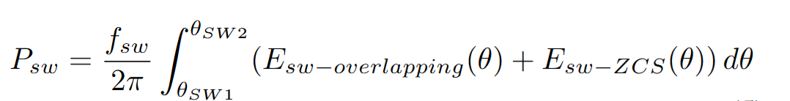
Inverter Losses
In a two-level inverter, we can assume the losses do not depend on the power factor.
We can control the modulation index and the current, then we can estimate the power loss for the desired operating points.
The efficiency can be estimated then using the power loss and operating point power.
2500
Dp1
Dp2
100% of power
600
Torque [Nm]
Power [kW]
Dp3
50% of power
Dp5
100% of power
Dp4
25% of power
Dp6
50% of power
0
2000
4500
6000
speed [rpm]

Slide 16
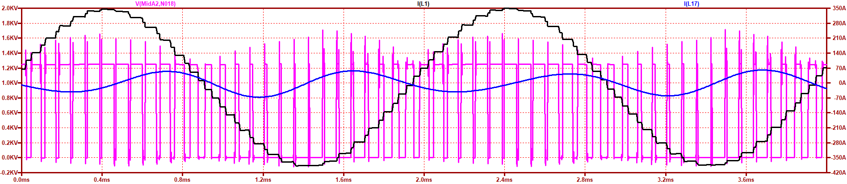
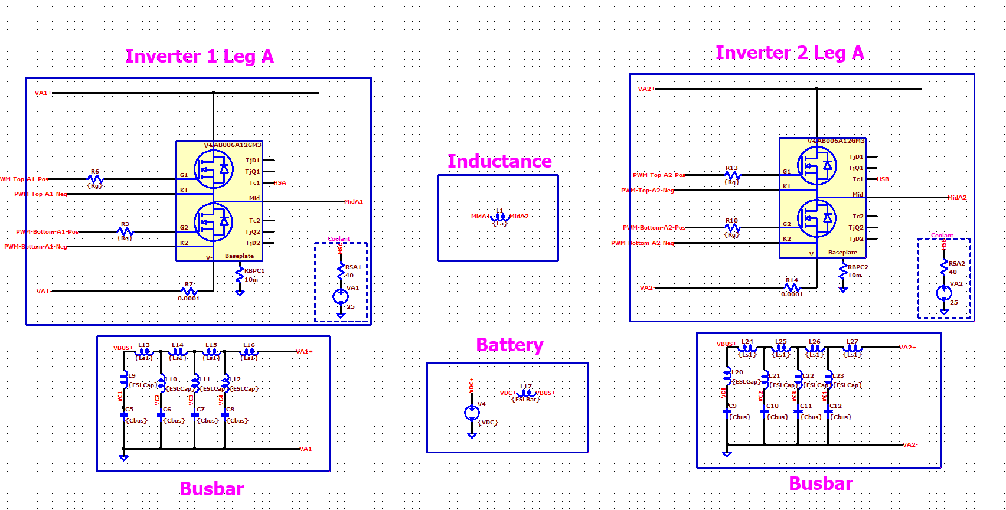
Phase-Shift Control
Controlling the current and apparent power. We do not have active control on power factor.

Slide 17
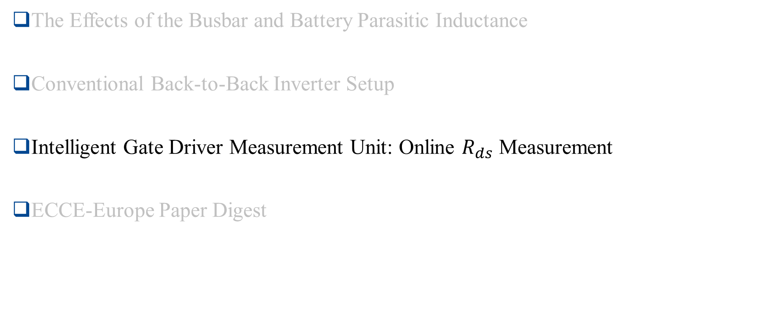
Outline
The Effects of the Busbar and Battery Parasitic Inductance
Conventional Back-to-Back Inverter Setup
Intelligent Gate Driver Measurement Unit: Online $R_{ds}$ Measurement
ECCE-Europe Paper Digest

Slide 18
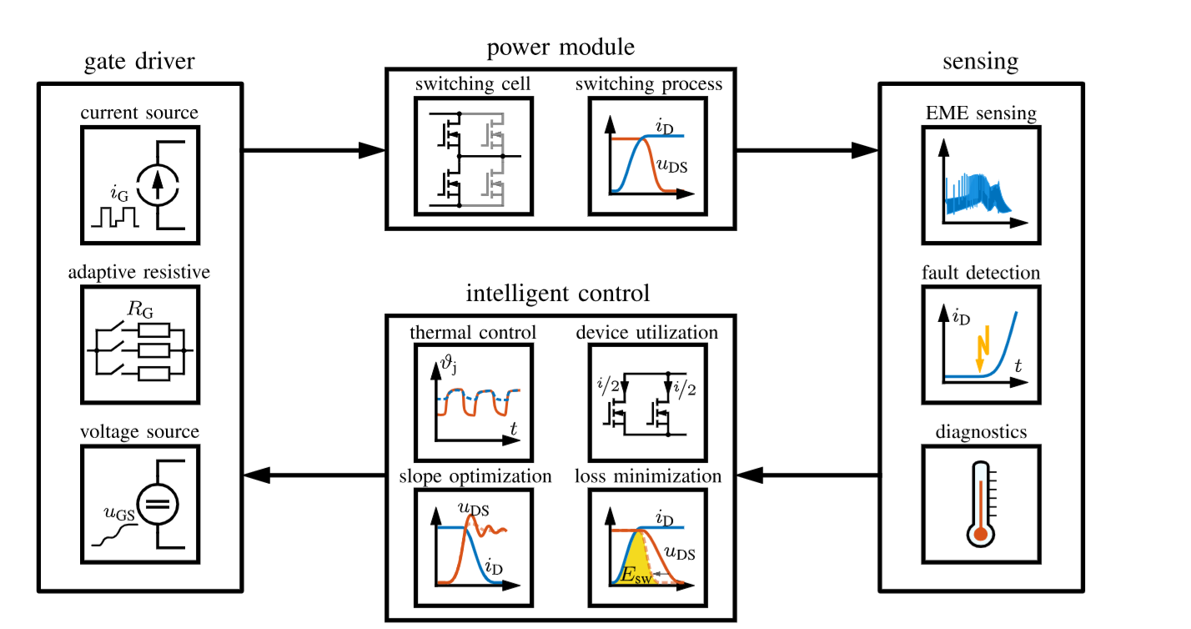
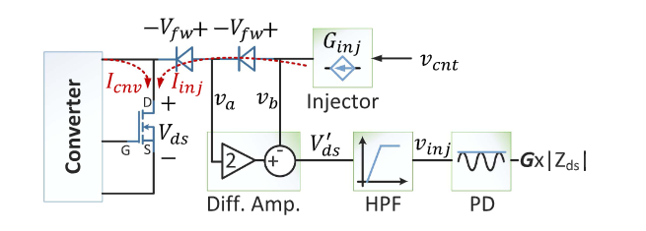
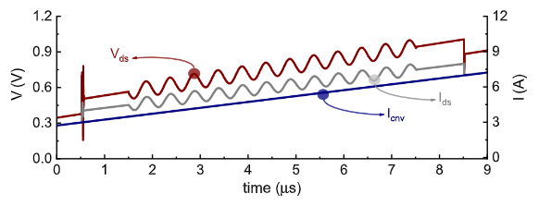
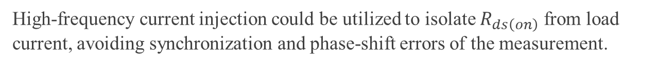
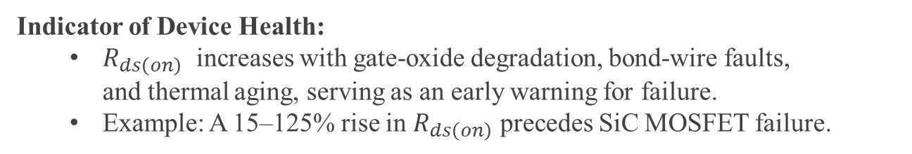
Intelligent Gate Drivers: Online $R_{ds}$ Measurement
Indicator of Device Health:
  $R_{ds\left(on\right)}$​ increases with gate-oxide degradation, bond-wire faults, and thermal aging, serving as an early warning for failure.
  Example: A 15–125% rise in $R_{ds\left(on\right)}$​ precedes SiC MOSFET failure.
Fault Prevention:
  Detects chip- and package-level defects (e.g., solder cracks, oxide traps) before catastrophic failure.
High-frequency current injection could be utilized to isolate $R_{ds\left(on\right)}$​​ from load current, avoiding synchronization and phase-shift errors of the measurement.
Fig: Intelligent Gate Drivers:
Sensing,control, gate drivers
F. Karakaya, "An Approach for Online Estimation of On-State Resistance in SiC MOSFETs Without Current Measurement,
Jochen Henn, ”Intelligent Gate Drivers for Future Power Converters”

Slide 19
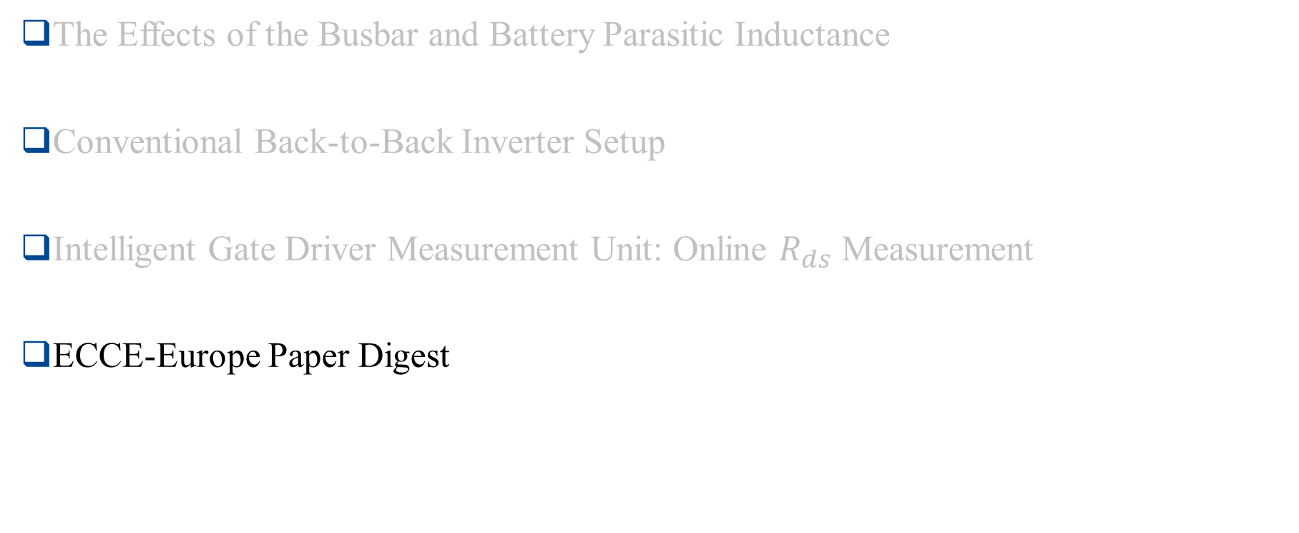
Outline
The Effects of the Busbar and Battery Parasitic Inductance
Conventional Back-to-Back Inverter Setup
Intelligent Gate Driver Measurement Unit: Online $R_{ds}$ Measurement
ECCE-Europe Paper Digest

Slide 20
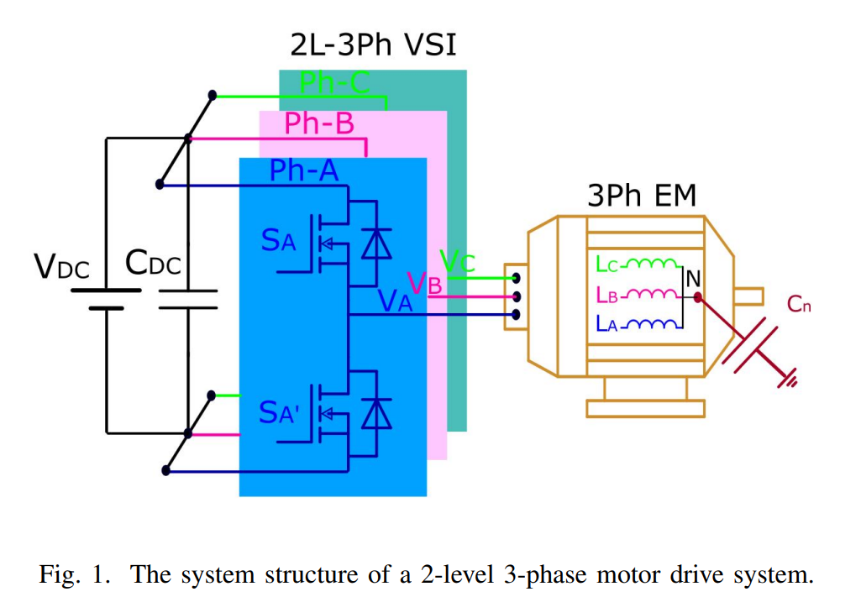
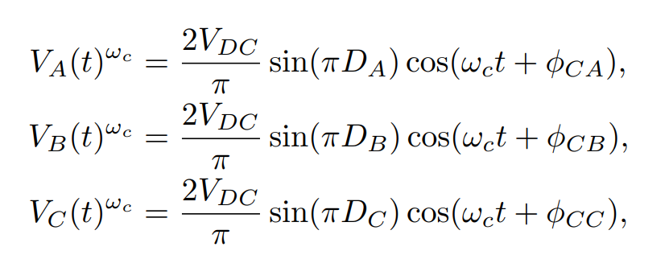
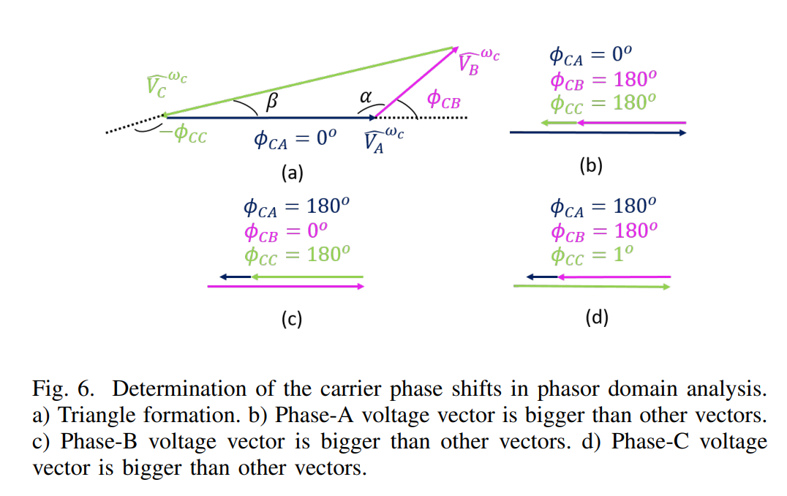
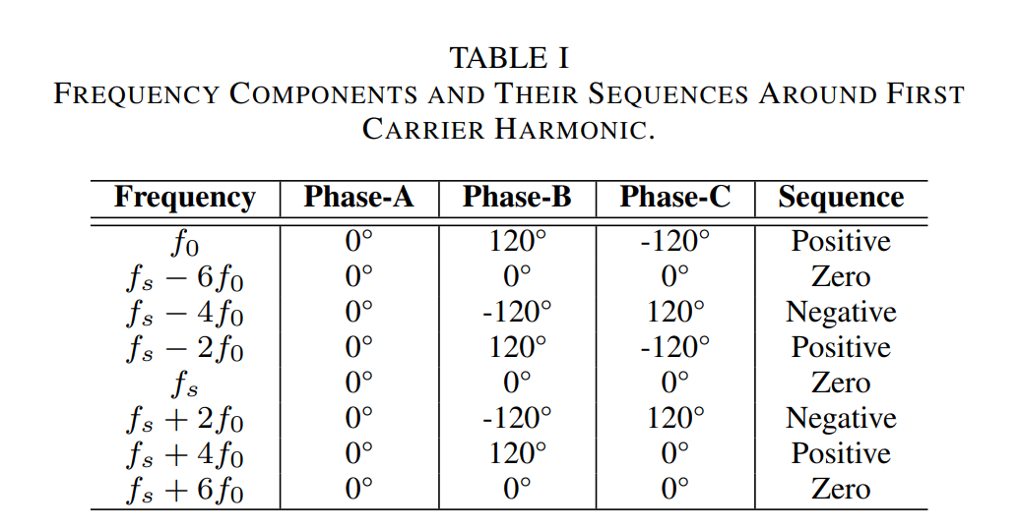
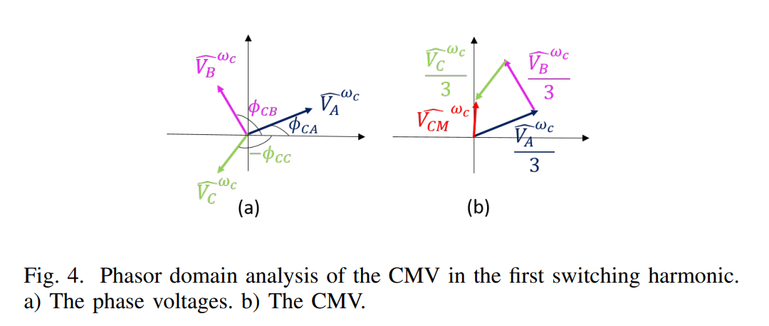
Common-Mode Voltage Reduction in Two-Level Inverters by Introducing Adaptive Carrier-Phase-Shift Method

Slide 21
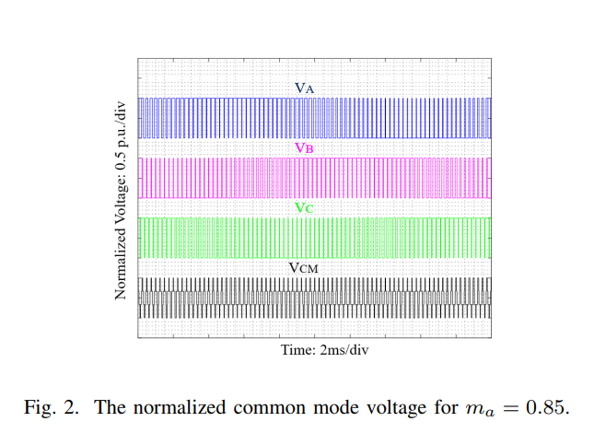
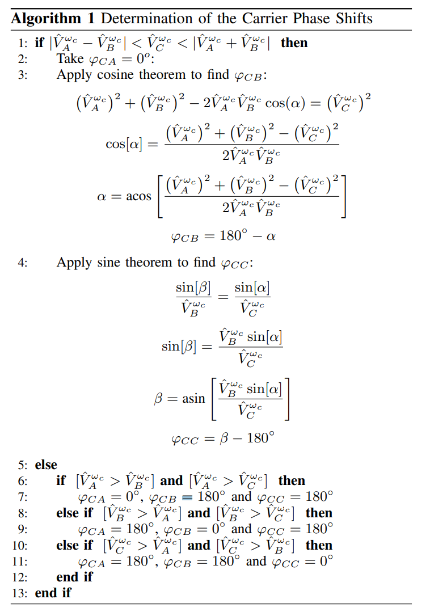
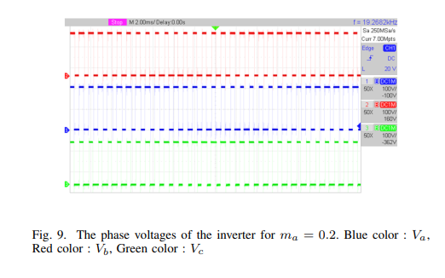
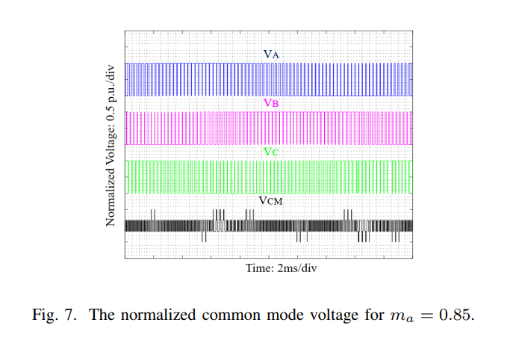
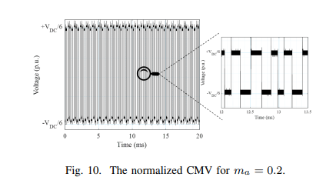
Common-Mode Voltage Reduction in Two-Level Inverters by Introducing Adaptive Carrier-Phase-Shift Method

